Slide 1
PowerShell with SQL Statement Data Gathering
PowerShell Devops global summit, 2023
Bruce Stump

Slide 2

A little bit about myself
Systems Administrator
Employer - Teachers Credit Union
20+ years of IT experience with over 15 years working with PowerShell.
Languages, whatever is needed to get the job done.
Twitter (@bstump123)
LinkedIn (https://www.linkedin.com/in/brucestump)
GitHub (https://github.com/bstump101)
Hobbies – blogging, chess, and fishing
Notes:
I am the Systems Administrator at Teachers Credit Union
I have over 20 years of IT experience with over 15 years working with PowerShell.
Languages is whatever I need to get the job done. I’ve started my IT career as a Web Developer Inter while in college. We programmed in PHP and MySQL. I also worked in Academia, in which I programmed in Perl, a little be of Ruby, and Bash. College pushed C++ and also had some Java and Python. I was comfortable programming in anything that had a C++ like syntax, so PowerShell was a natural fit. I also wasn’t very fond of Windows Batch scripting, so the more I could utilize PowerShell the better.
Here are my twitter and LinkedIn accounts, and then my GitHub space
Hobbies include blogging, chess, and fishing.

Slide 3

Source Files for Presentation (GitHub)
https://github.com/bstump101/PowerShellWithSQLStatementDataGathering
Notes:
Location of PowerShell Modulec and Slides of this Presentation

Slide 4

Teachers Credit Union is a not-for-profit financial institution in Indiana and Michigan that was founded in 1931 in South Bend, Indiana.

Slide 5
What is
PowerShell with SQL Statement Data Gathering?
Notes:
A phrase I created that explains the process to capture data from an SQL Query so that PowerShell can manipulate the data as needed.

Slide 6
Systems Administrator Role (keep the lights on)
Applications
Processes
Services
Databases
Networking
Etc.
What if service depends on transactional data?
Notes:
The reason I picked this topic is because at TCU, we needed a way to monitor Transactional data from our LynxGate System. We have monitoring tools that can monitor services, process, applications, etc. Transactional data may need a different approach to monitoring than a normal service or process would be monitored, which leads me to the topic of this discussion.

Slide 7
Monitor ATM Transactions
Problem
Notes:
Automate – Not licensed to use PowerShell in Automate, there are ways to work around this, but would have to utilize Automate Scripting, PowerShell Scripting, and batch scripting.
SolarWinds – Can use PowerShell with SolarWinds, but current licensing only allows us to query a database through scripting and we only get a success or failure, no information on status of the data.
RPA (UIPath) – Would utilize screen scraping, how a human would interact with the LynxGate Interface.
PowerShell – Connect directly to the source, already had the SQL Queries, just had to set up the process.

Slide 8
Automate
SolarWinds
RPA (UIPath)
PowerShell
Possible Solutions
Notes:
Automate – Not licensed to use PowerShell in Automate, there are ways to work around this, but would have to utilize Automate Scripting, PowerShell Scripting, and batch scripting.
SolarWinds – Can use PowerShell with SolarWinds, but current licensing only allows us to query a database through scripting and we only get a success or failure, no information on status of the data.
RPA (UIPath) – Would utilize screen scraping, how a human would interact with the LynxGate Interface.
PowerShell – Connect directly to the source, already had the SQL Queries, just had to set up the process.

Slide 9
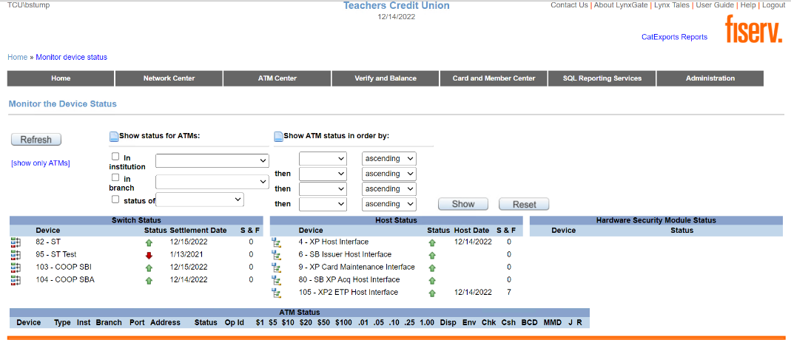
LynxGate Interface
Notes:
LynxGate is software that processes transactions from ATM’s and point of sales systems and posts them to the XP system.
XP is the financial core to Teachers Credit Union.

Slide 10
SQLServer Module
Invoke-SqlCmd
Install-Module SQLServer
Import-Module SQLServer or Import-Module –Cmdlet Invoke-SqlCmd
Install SQL Module from PowerShellGet

Slide 11
ITOpsVerifcation Module – Contains LynxGate Cmdlets
Install-Module ITOpsVerification –Repository <RepositoryName>
Import-Module ITOpsVerification
Install ITOpsVerification Module (Custom Module)

Slide 12
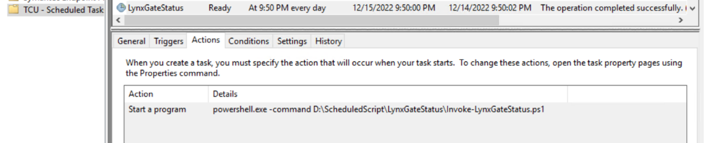
Scheduled Task – Actions

Slide 13
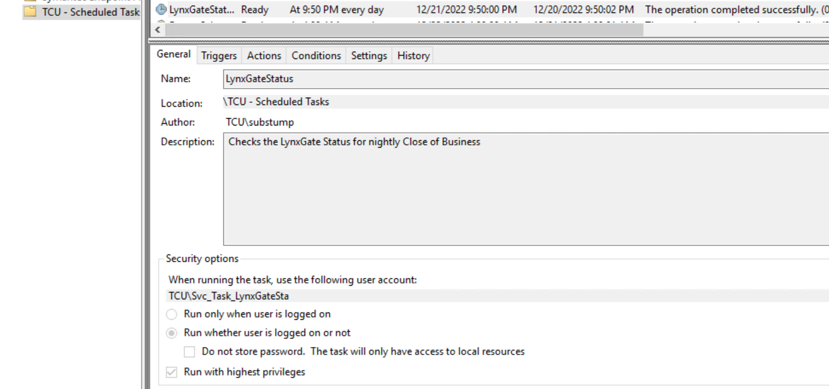
Scheduled Task - General

Slide 14
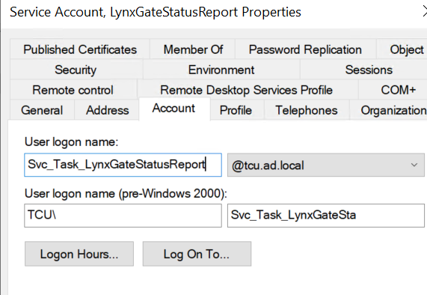
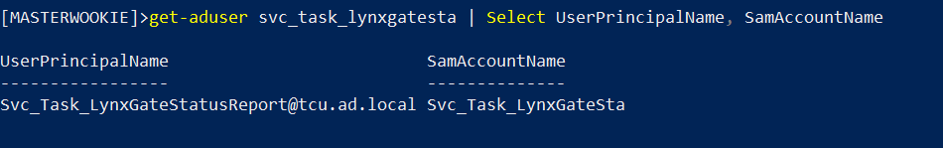
Svc_Task_LynxGateStatusReport
(20 Character limit)

Slide 15
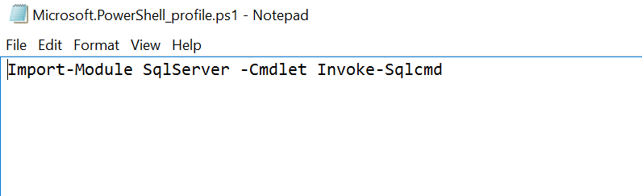
Profile (Svc_Task_LynxGateStatusReport)

Slide 16
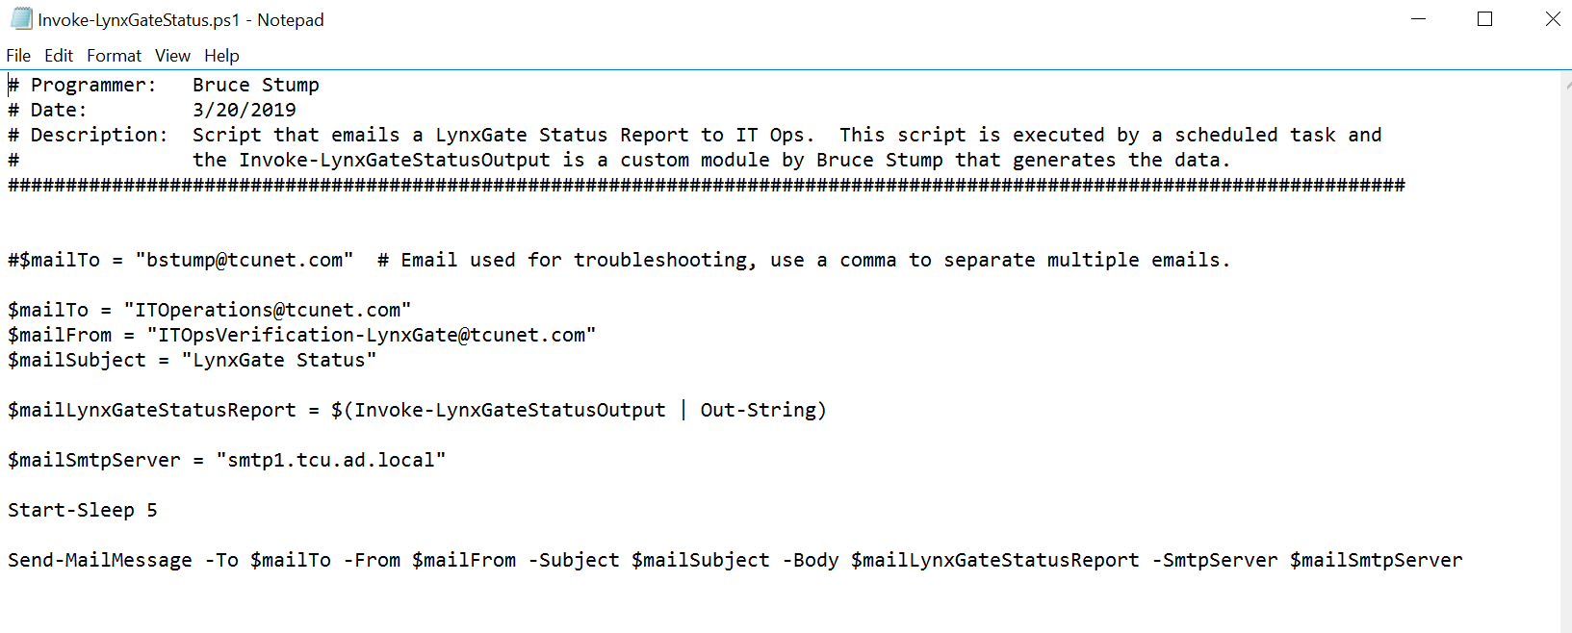
Invoke-LynxGateStatus.ps1

Slide 17
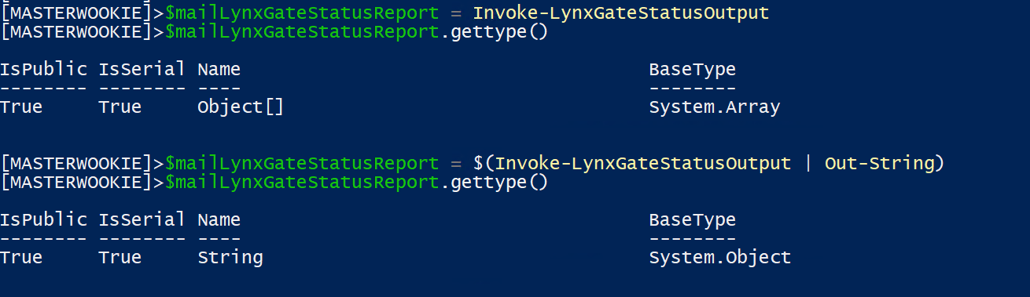
$mailLynxGateStatusReport
Notes:
$mailLynxGateStatusReport needs to be a string, that is why Invoke-LynxGateStatusOutput is piped to ‘Out-String’, otherwise it would be an array and the send-mailmessage cmdlet would fail.

Slide 18
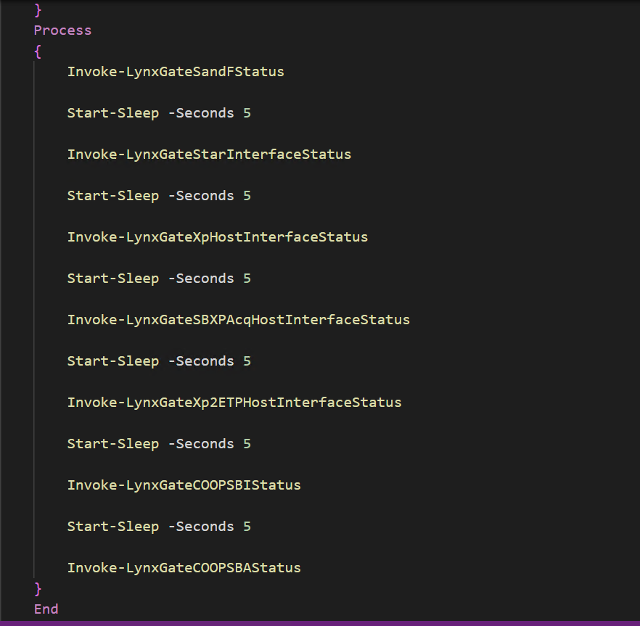
Invoke-LynxGateStatusOutput
Notes:
Shared Branching – process by which members of other credit unions may process transactions at TCU via ZP2 or members of TCU may process their transactions at TCU.
SBA – Shared Branching Acquirer
SBI – Shared Branching Issuer
XP2 ETP Host Interface – ATM Transactions
SB XP Acq Host Interface
XP Host Interface
Start Interface

Slide 19
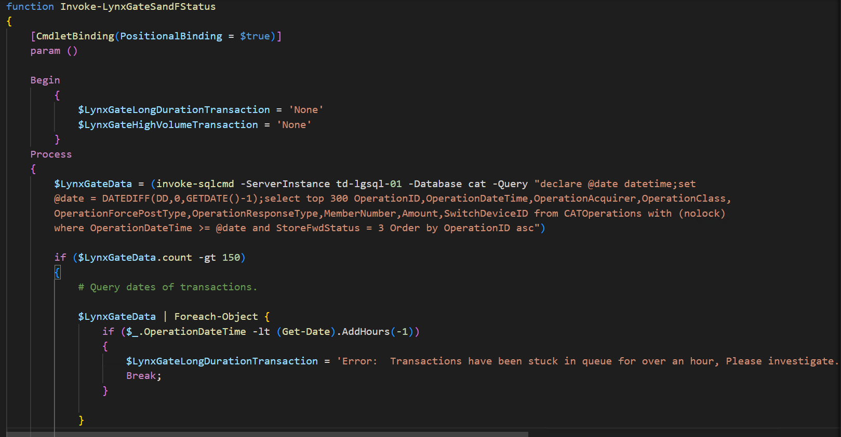
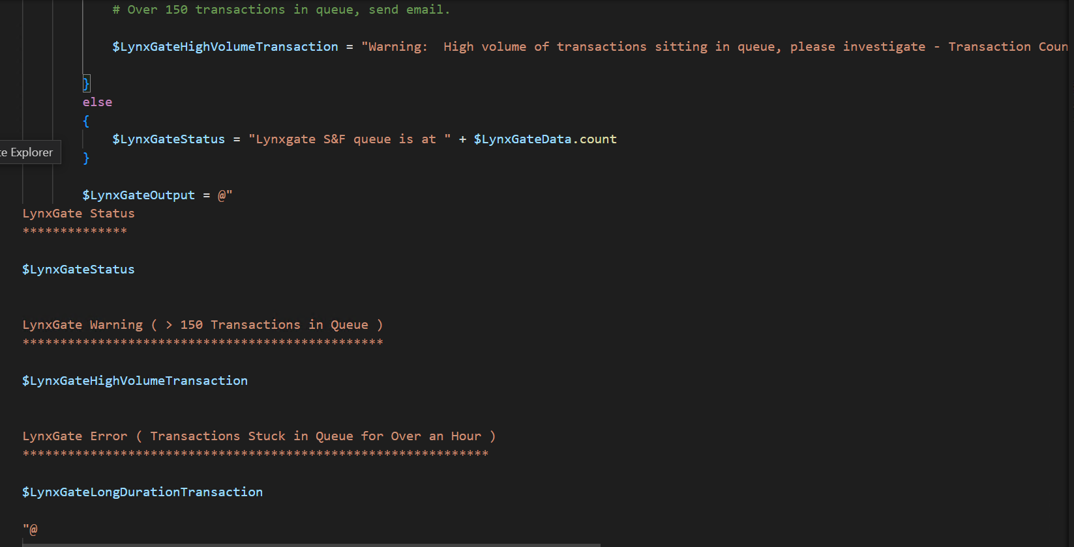
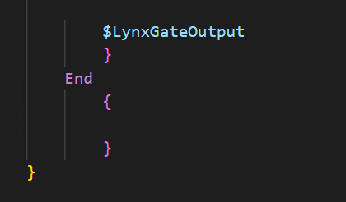
Invoke-LynxGateSandFStatus

Slide 20
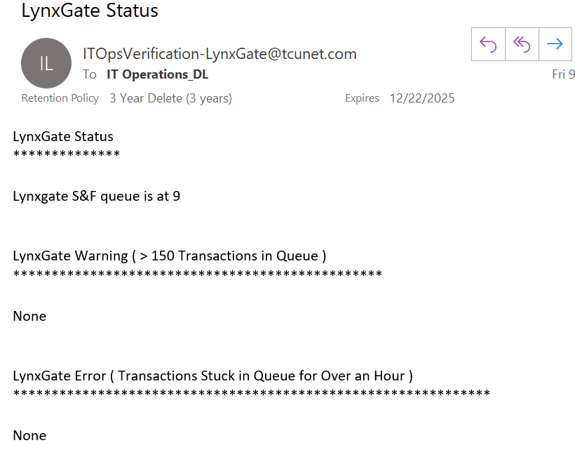
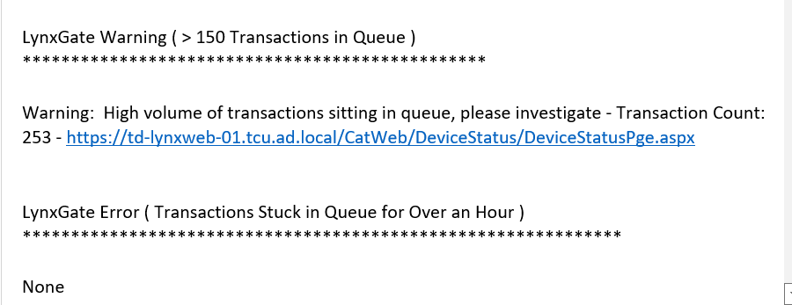
Invoke-LynxGateSandFStatus (Sample Email)

Slide 21
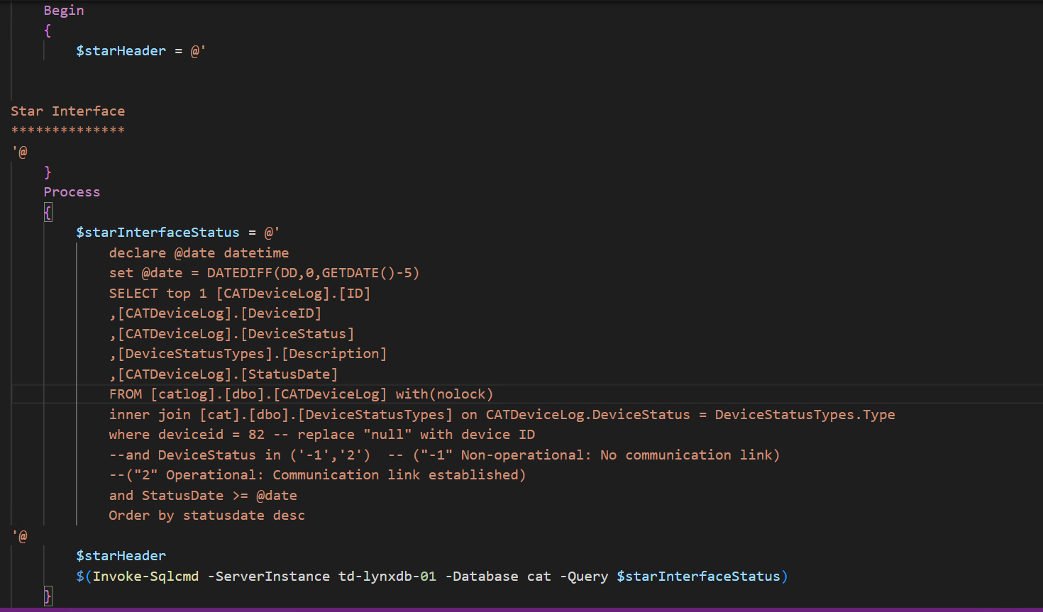
Invoke-LynxGateStarInterfaceStatus
Notes:
Last 5 days
DeviceLog ID, Device ID, Device Status, Device Status Description, Status Date

Slide 22
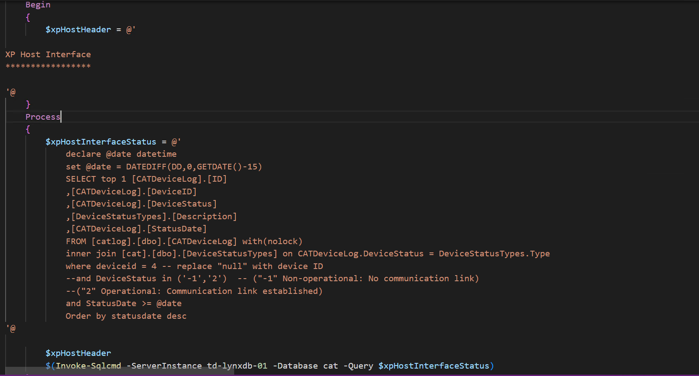
Invoke-LynxGateXpHostInterfaceStatus
Notes:
Last 15 days
DeviceLog ID, Device ID, Device Status, Device Status Description, Status Date

Slide 23
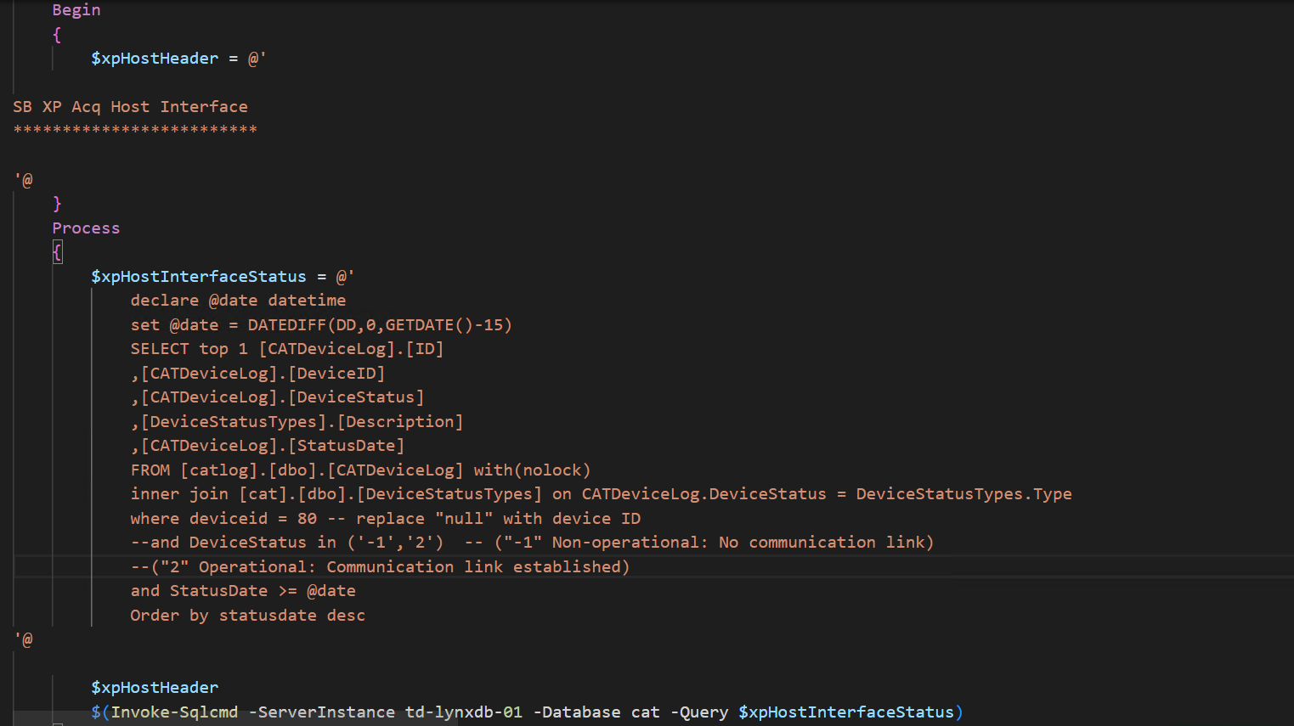
Invoke-LynxGateSBXPAcqHostInterfaceStatus
Notes:
Last 15 days
DeviceLog ID, Device ID, Device Status, Device Status Description, Status Date

Slide 24
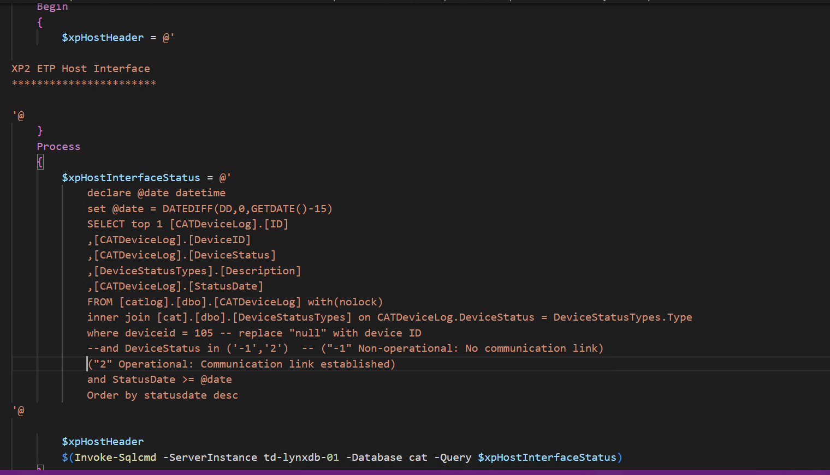
Invoke-LynxGateXp2ETPHostInterfaceStatus
Notes:
Last 15 days
DeviceLog ID, Device ID, Device Status, Device Status Description, Status Date

Slide 25
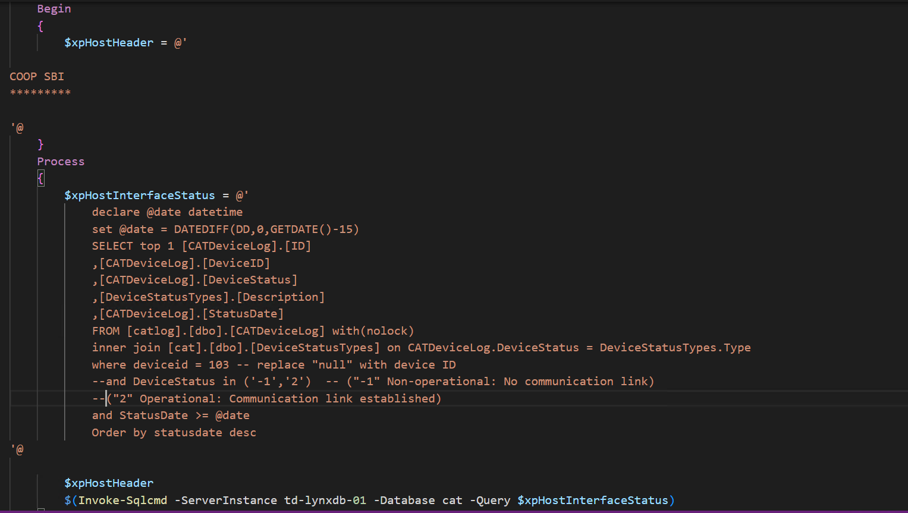
Invoke-LynxGateCOOPSBIStatus
Notes:
Last 15 days
DeviceLog ID, Device ID, Device Status, Device Status Description, Status Date

Slide 26
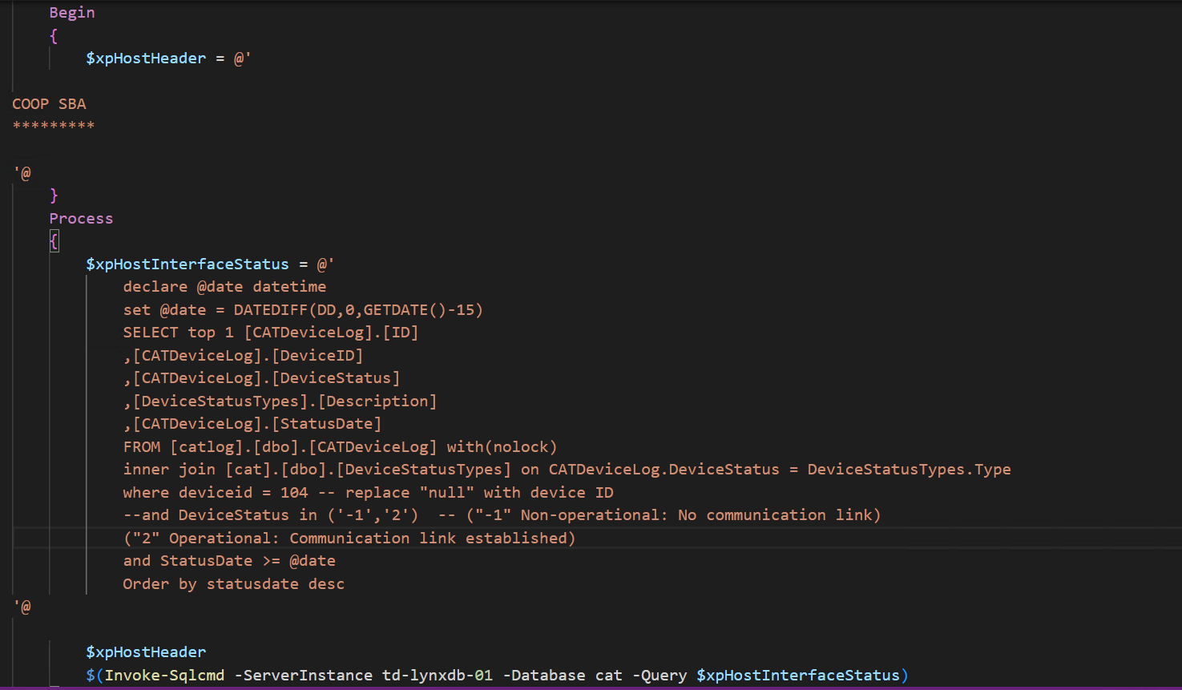
Invoke-LynxGateCOOPSBAStatus
Notes:
Last 15 days
DeviceLog ID, Device ID, Device Status, Device Status Description, Status Date

Slide 27
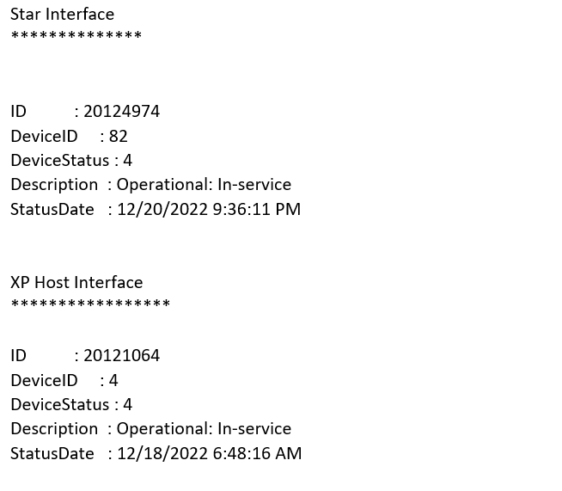
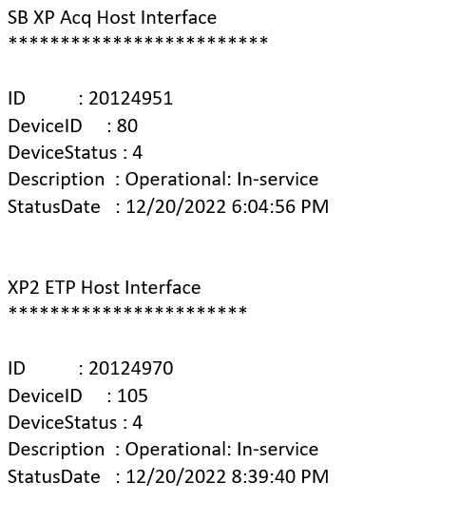
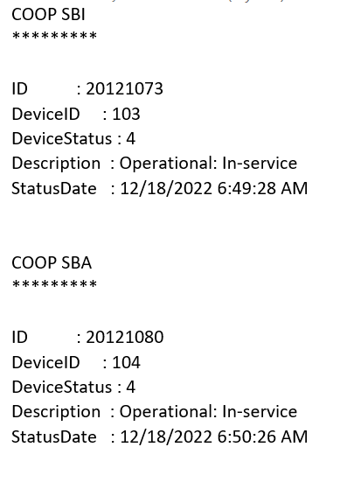
Invoke-LynxGateSandFStatus (Sample Email)

Slide 28
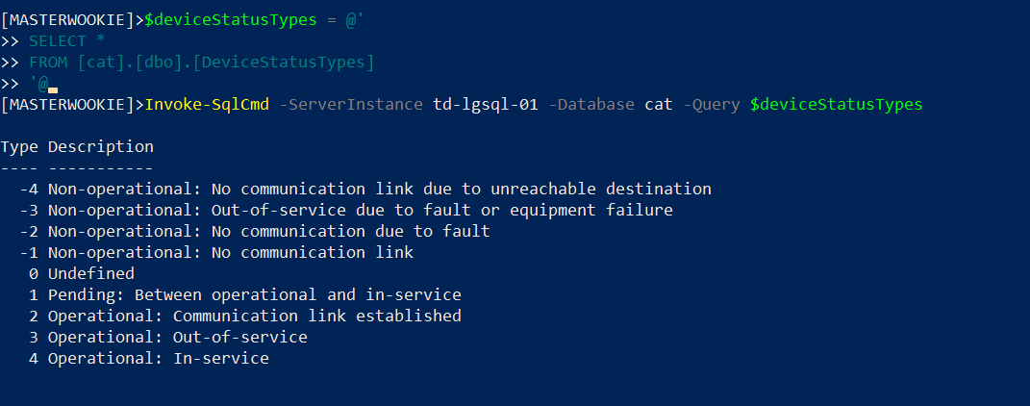
Device Status Types

Slide 29
Demo
Invoke-LynxGateSandFStatus
Invoke-LynxGateStarInterfaceStatus
Invoke-LynxGateXpHostInterfaceStatus
Invoke-LynxGateSBXPAcqHostInterfaceStatus
Invoke-LynxGateXp2ETPHostInterfaceStatus
Invoke-LynxGateCOOPSBIStatus
Invoke-LynxGateCOOPSBAStatus
Invoke-LynxGateStatusOutput

Slide 30
Questions?

